Slide 1






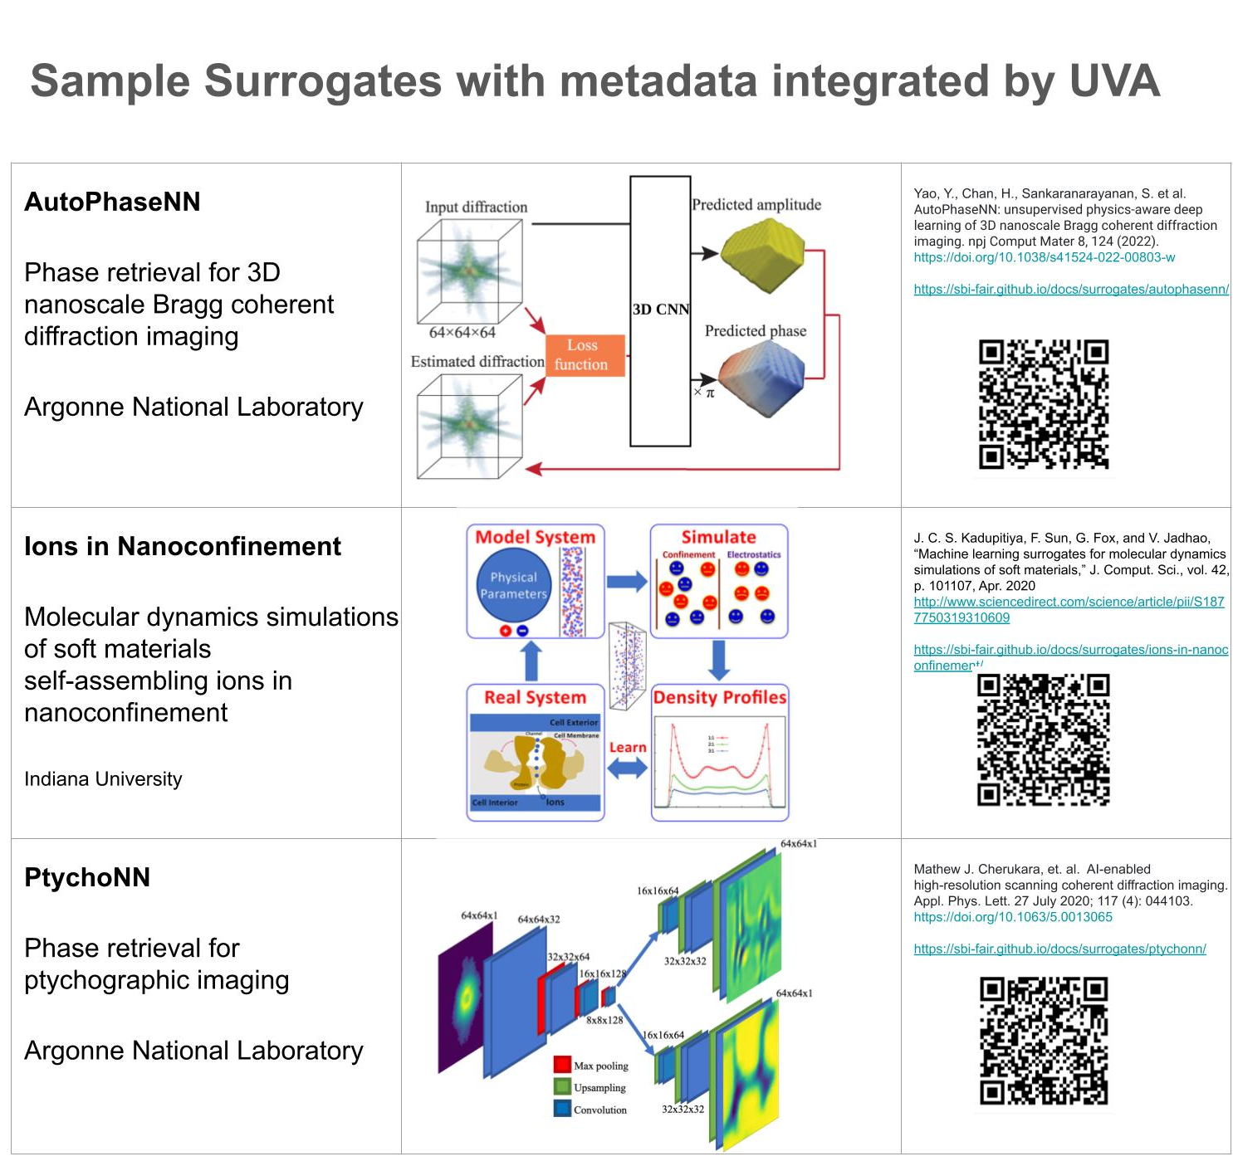
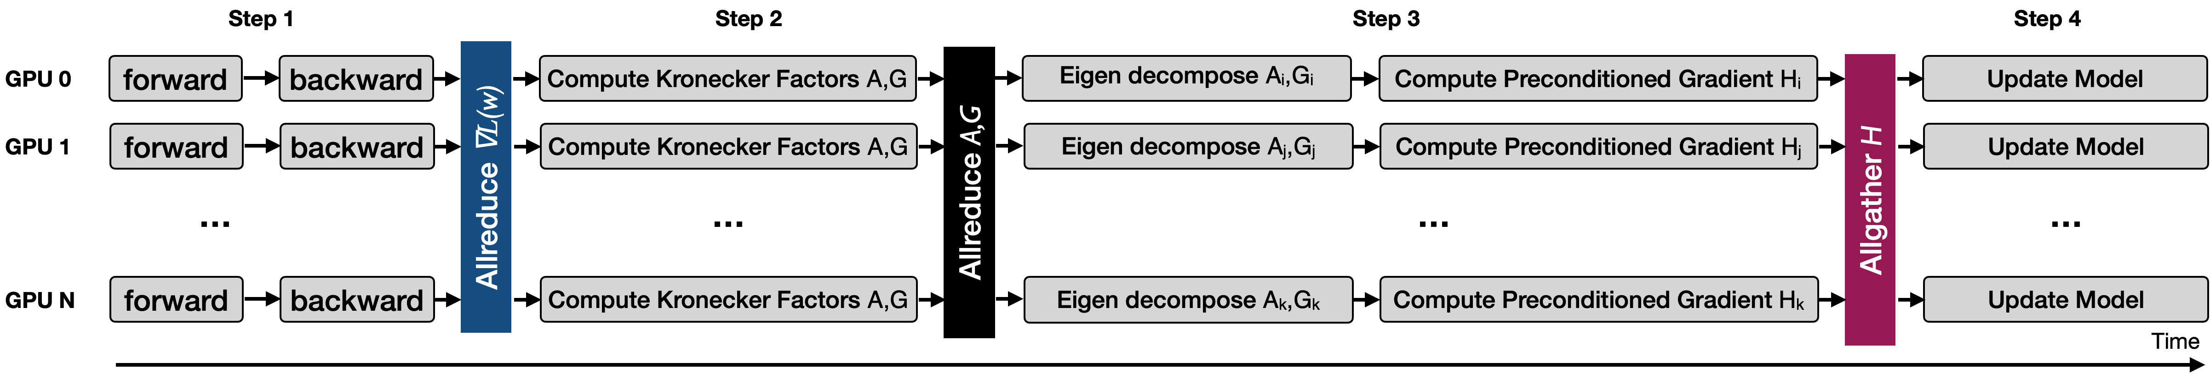
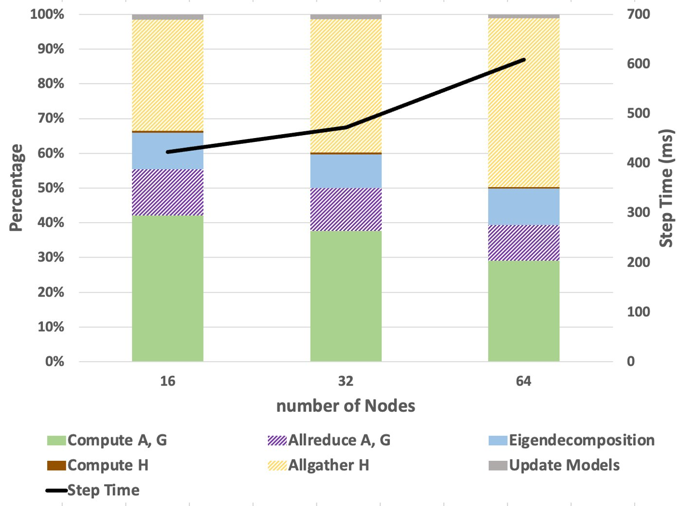
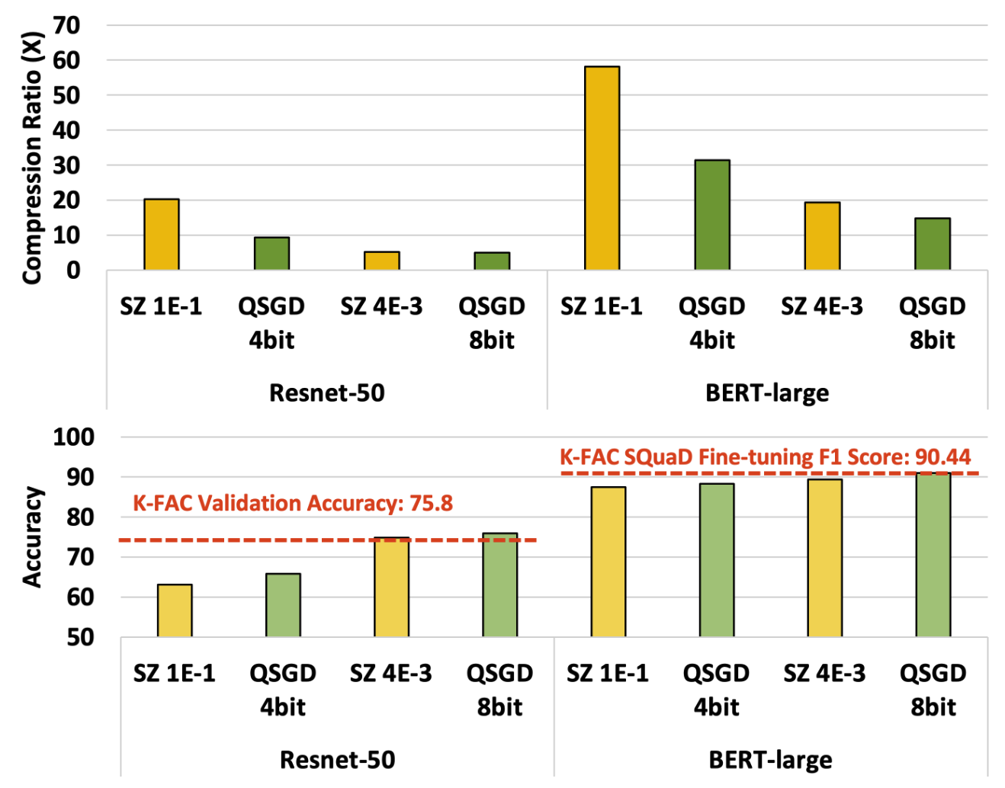
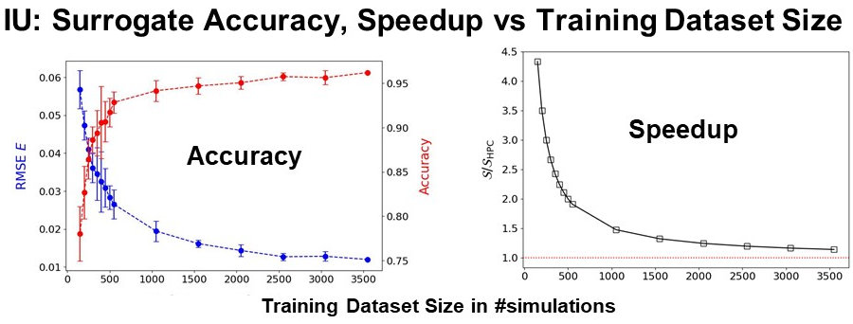
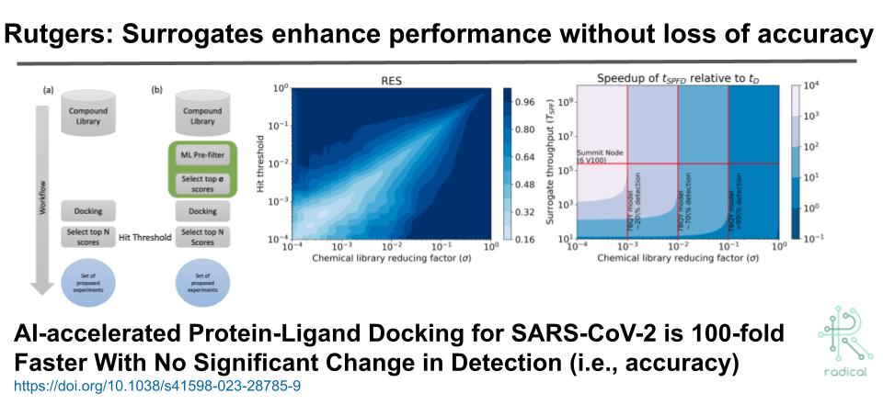
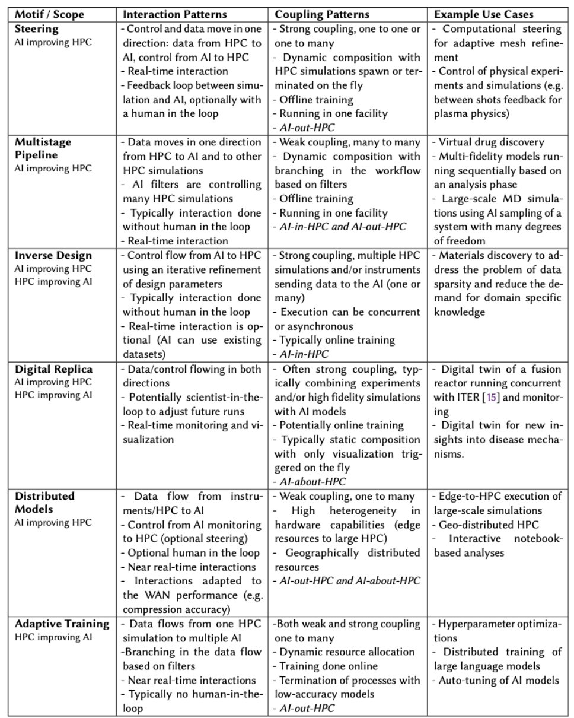
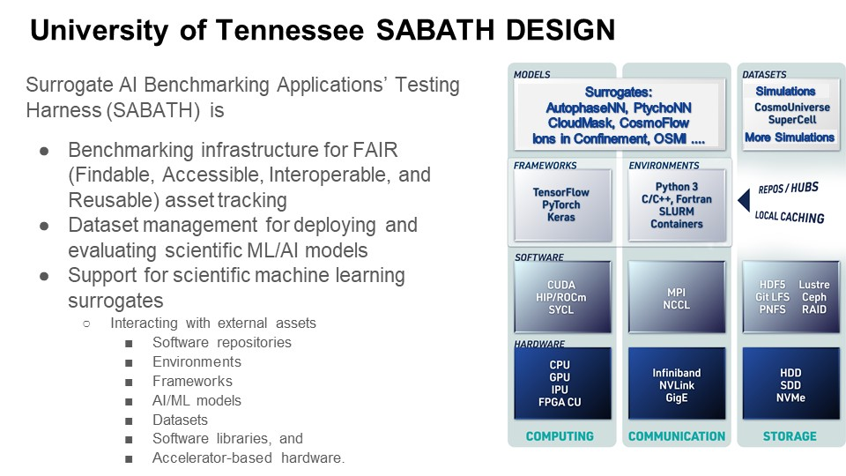
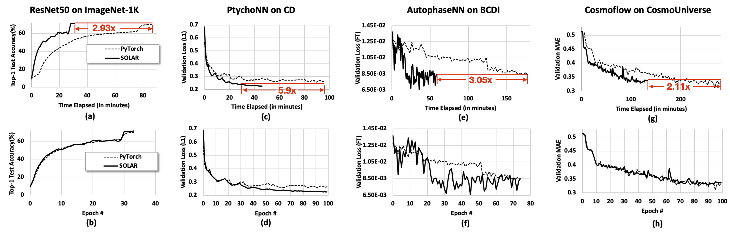
Surrogate Benchmark Initiative SBI: FAIR Surrogate Benchmarks Supporting AI and Simulation Research
Geoffrey Fox¹, Pete Beckman², Shantenu Jha³, Piotr Luszczek⁴, Vikram Jadhao⁵ ¹Virginia University, ²Argonne Natl Lab, ³Rutgers, ⁴University of Tennessee, ⁵Indiana University
Abstract
Selected Highlights
The five institutions and MLCommons accumulate Generative and Regressive simulation surrogates and make them available in repositories with FAIR access. We produce a taxonomy across domain and system architectures with examples. We study performance and accuracy from AI, system I/O and communication aspects, as well as the size and nature of the training set. We look at batching and compression approaches as well as use of I/O parallelism and improved communication performance.
ANL Scalable Communication Framework for Second-Order Optimizers
Background:
Kronecker-factored Approximate Curvature (K-FAC)​
Step1: Forward and backward computation, Allreduce gradient ∇𝐿(w).​
Step2: For all layers, compute Kronecker factors, Allreduce factors A and G.​
Step3: For assigned layer l, eigen decompose Al ,Gl and compute preconditioned gradient Hl , Allgather Hl .​
Step4: Update model weights using preconditioned gradient H.​
Challenges:
Motivation:
Preserving accuracy while achieving high CR.
Achieving end-to-end performance improvement considering the system and compression/decompression overhead.
Existing compressors either significantly impacts accuracy or have limited compression ratio.
Motivation
Allreduce takes 10%​
Easy access to state of the art modern AI is very important and surrogates are a transformational AI approach to simulations.
Allgather takes up to 50%​
Potential Impact
SBI will make it easier for general users to develop new surrogates and help make their major performance increases pervasive across DoE computational science. Surrogates are openly available through MLCommons or SBI Repository.
Rutgers 6 Motifs
With mini-apps
Collaboration Opportunities
Benefits: Techniques and methodology for generating high performance surrogates. Examples to use in education and as starting points for new surrogates. We would be happy for other surrogates from collaborators.
ANL I/O Speedup
PyTorch
SOLAR-ANL
Selected References
1. SBI Web page https://sbi-fair.github.io/ (has full list of publications)
2. E. A. Huerta, et. Al., FAIR for AI: An interdisciplinary and international community building perspective. Scientific Data, 10(1):487, 2023. URL:.
https://doi.org/10.1038/s41597-023-02298-6
ASCR Award DE-SC0023452
Notes:
Notes: Can choose to use either Preliminary Results or Key Achievements depending on stage of the project.

